Slide 1
DATABASE MANAGEMENT SYSTEM PROJECT
FITNESS CENTER
BY:
YOGESH DARJI (ypd150030)
JOYDEEP ROY (jxr150430)
AKSHAY KHATRE (ast140230)

Slide 2
PROJECT DESCRIPTION
WHY IS FITNESS CENTER SYSTEM IMPORTANT?
In todays world, heath and fitness plays and important role. Managing the fitness center to fulfill the needs of users is really important
Database system can at times becomes complex as there are many relations involved among different entities
In this project we show case the complex Fitness Center System by a simplified Entity-Relationship Diagram
We make sure that the Relational Schema will fulfill all the needs of Fitness Center

Slide 3
REQUIREMENTS
The Users of the Fitness Center Database Application are :
CUSTOMERS
EMPLOYEES
Manager
Trainer
Clerk

Slide 4
REQUIREMENTS
CUSTOMERS
Customers will use the System to access their Batch Details, Trainer, Branch Details and Customer Report
Customer can register for the Fitness Center
Customer can update the their Profile
Customer can see what all Facilities are available to them
Customer can upgrade their membership
Customer can access different batches available
Customer can access trainers and type of Equipments available

Slide 5
REQUIREMENTS
MANAGER
Manager will manage the entire Fitness Branch
Manager will manage the Trainer, Clerk and assign work to them
Manager would be responsible for creating Batches
TRAINER
Trainer will run the batches and also provide Personal Training to Customers
CLERK
Clerk will manage all the clerical activities like manage Customer Report and maintaining Equipments

Slide 6
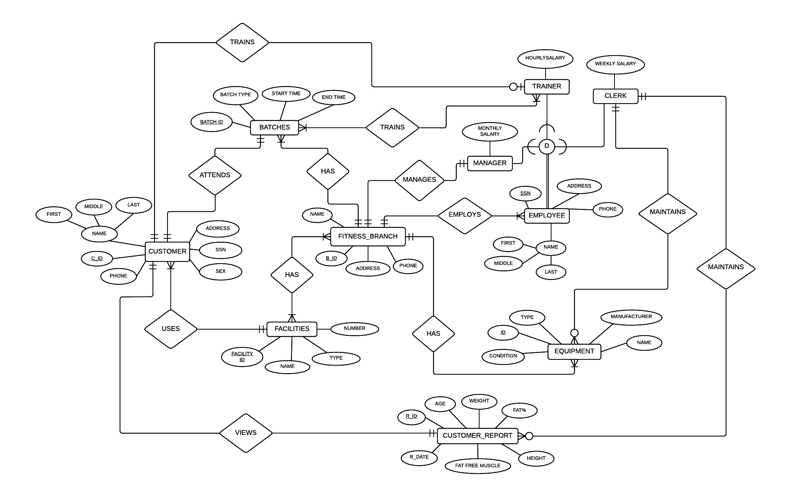
ER DIAGRAM

Slide 7
ASSUMPTIONS
One Facility can used multiple by multiple Customers provided at the Fitness Center
One Clerk maintains multiple Customer Report
One Fitness-Branch can have multiple Equipments
We store a single updated Fitness Report for each Customer
A Customer would be attending one Batch
A Customer may or may not have a Personal Trainer
An Employee can be a Manager, Trainer or a Clerk
A Clerk may or may not maintain Equipments
There is One Manager for a each Fitness-Branch

Slide 8
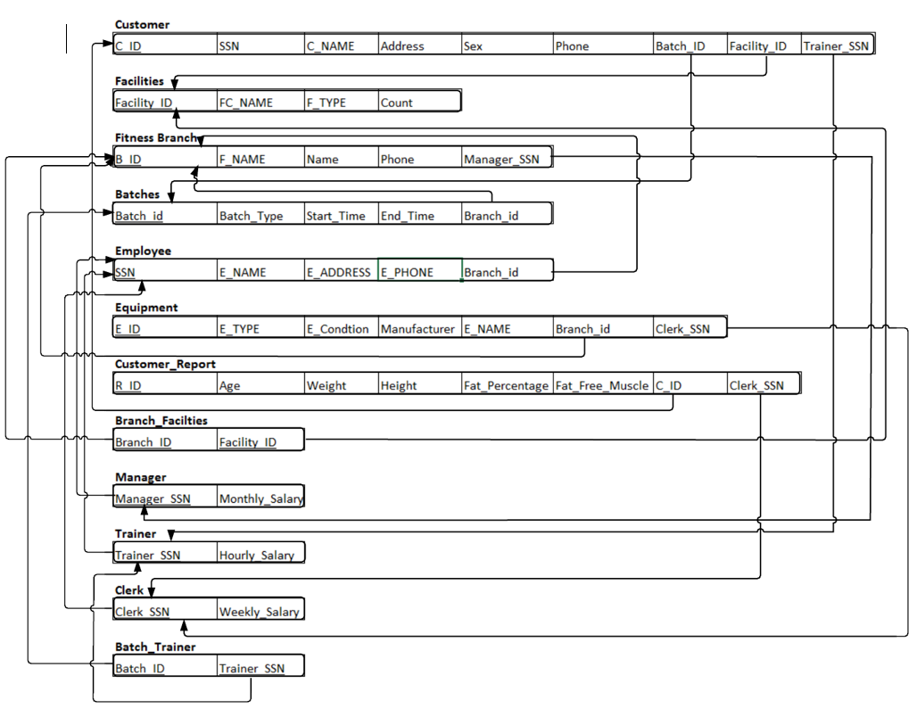
RELATIONAL SCHEMA

Slide 9
STORED PROCEDURE
Procedure to generate a report of Equipments for particular Branch ID
IF condition is set to ALL, then ALL the EQUIPMENTS of that particular BRANCH will be displayed
ELSE we can filter on specific EQUIPMENT condition like ‘Went for Repair’, ‘Working’, etc

Slide 10
STORED PROCEDURE
CREATE OR REPLACE PROCEDURE EQ_STATUS_CHECK (BRANCHID IN EQUIPMENT.BRANCH_ID%TYPE, EQCOND IN EQUIPMENT.E_CONDITION%TYPE)AS
BEGIN
DECLARE
B_ID EQUIPMENT.BRANCH_ID%TYPE;
E_COND EQUIPMENT.E_CONDITION%TYPE;
EQDesc EQUIPMENT%ROWTYPE;
CURSOR EQUIPMENT_DETAILS IS SELECT * FROM EQUIPMENT WHERE BRANCH_ID = BRANCHID; --ORDER BY BRANCH_ID,E_CONDITION;
BEGIN
OPEN EQUIPMENT_DETAILS;
DBMS_OUTPUT.PUT_LINE('Equipment details for Branch ' ||BRANCHID);
LOOP
FETCH EQUIPMENT_DETAILS INTO EQDesc;
EXIT WHEN (EQUIPMENT_DETAILS%NOTFOUND);
IF(EQCOND = 'ALL') THEN
DBMS_OUTPUT.PUT_LINE(' '||EQDesc.E_ID||' '||EQDesc.E_NAME||' '||EQDesc.MANUFACTURER||' '||EQDesc.CLERK_SSN);
ELSE
IF(EQCOND = EQDESC.E_CONDITION) THEN
DBMS_OUTPUT.PUT_LINE(' '||EQDesc.E_ID||' '||EQDesc.E_NAME||' '||EQDesc.MANUFACTURER||' '||EQDesc.CLERK_SSN);
END IF;
END IF;
END LOOP;
CLOSE EQUIPMENT_DETAILS;
END;
END EQ_STATUS_CHECK;
SET SERVEROUTPUT ON;
BEGIN
EQ_STATUS_CHECK('B0001','REPAIR');
END;

Slide 11
THANK YOU

Slide 12

QUESTIONS??

